Slide 1
Computer organization and architecture
Session – 3

Slide 2
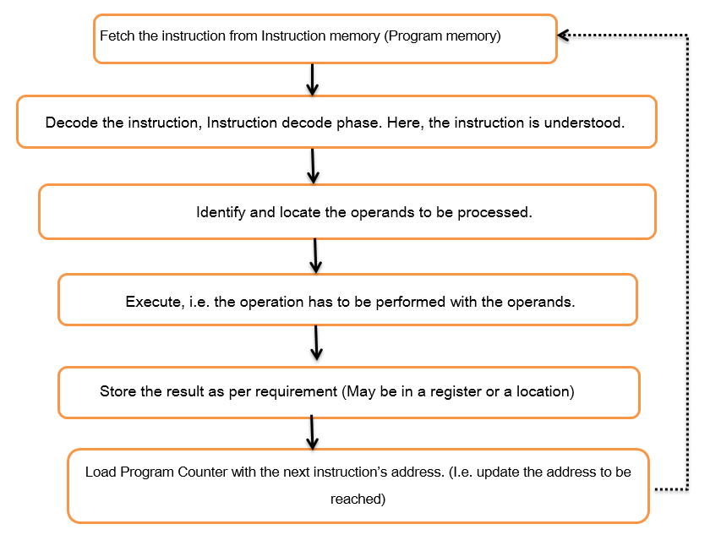
Instruction Execution Cycle and Terms Recap.
A program is nothing but collection of instructions and all the instructions gets pulled one after another from the memory (don’t worry which memory we are talking about, it is just memory).
Then, the process of understanding what the instruction is all about begins.
Followed by this, there would be computation and storing the result.
One can simply call this as Fetch, Decode and Execute, which is more technical as well.
But, to establish a better understanding it is needed to go with a deeper flow. (see RHS)

Slide 3
Some fundamental terms for recap…
Program counter: A register which holds the address of the next instruction (subsequent instruction) to be executed. This enables faster execution. Program counter is a register and it cannot be accessed by the programmer. Or, the programmer does not know the address of the program counter. It is purposefully hidden from the programmers view.
Stack and Stack Pointer: Stack is a temporary storage area where the values can be stored. For an instance when a function is called like add (3,4), the arguments 3,4 would be kept in the stack (the operation is called pushing) and it is a temporary storage area. Once the function call is done and result is ready, the result will be again kept on the top of the stack. Once the execution is complete, the stack can be cleaned (the operation is referred to as popping). Stack pointer is a register used to point the stack.
Bus: The channel through with the information flows. The data could be the address or the data from a particular location. If the bus carries the data, it is called data bus and in case addresses go through the bus, it is referred as address bus. There are control signals to be sent for controlling actions and in that case, the bus is referred as control bus.

Slide 4
CISC vs. RISC
Recap from previous semester.

Slide 5

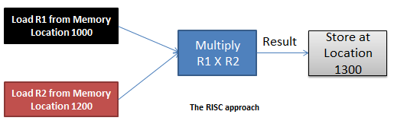
INTEL
The CISC Approach
MUL R1, R2 ; Multiply the content from R1 and R2. Store result in R1
APPLE COMPUTERS (Efficient)
LOAD $R1, @Location 1000; Here, Register R1 is loaded with content from 1000.
LOAD $R2, @Location 1200; Here, Register R2 is loaded with content from 1200.
MUL R1, R2 ; Multiply the content from R1 and R2. Store result in R1
STORE @Location 1300, R1; Store the result at 1300 from R1.

Slide 6
So…
Intel believes in hardware bearing more responsibility, making the coding simple. I.e. the developers shall be writing minimal lines of code. Apple believes the other way round. The philosophy is, hardware has to be simple and software has to lift most of the responsibility. Means, the developers will have a tough job of writing more lines of code with this architectural approach

Slide 7
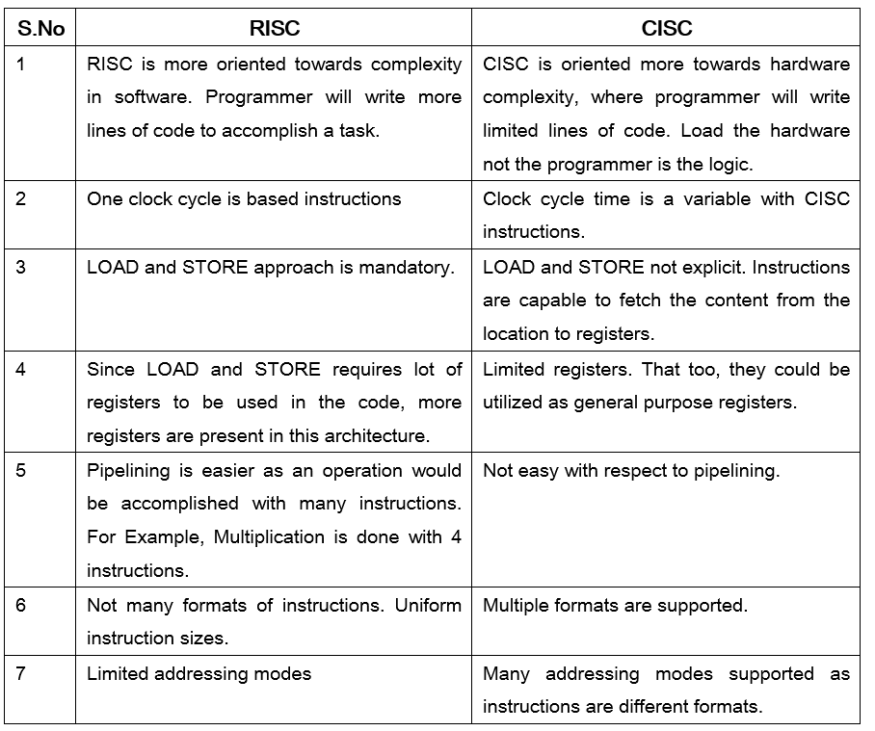

Slide 8
Little Endian and Big Endian Formats – A Clear understanding.
Recap from previous semester.

Slide 9

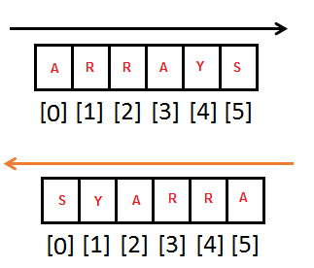
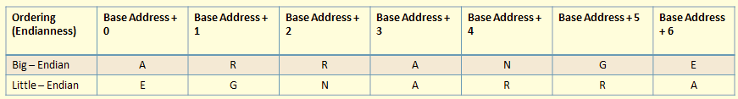
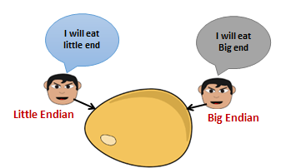

AN EMPTY ARRAY
The advantage!
S.NO | Little Endian | Big Endian
1 | MS Paint | JPEG
2 | RTF | Adobe Photoshop
3 | BMP | Mac Paint

Slide 10
Harvard and Von-Neumann Architecture – Let’s uncover the jargons
Recap from previous semester.

Slide 11
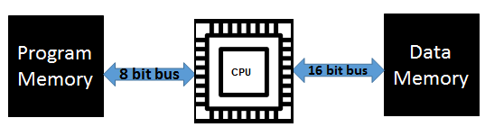
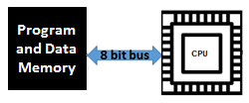
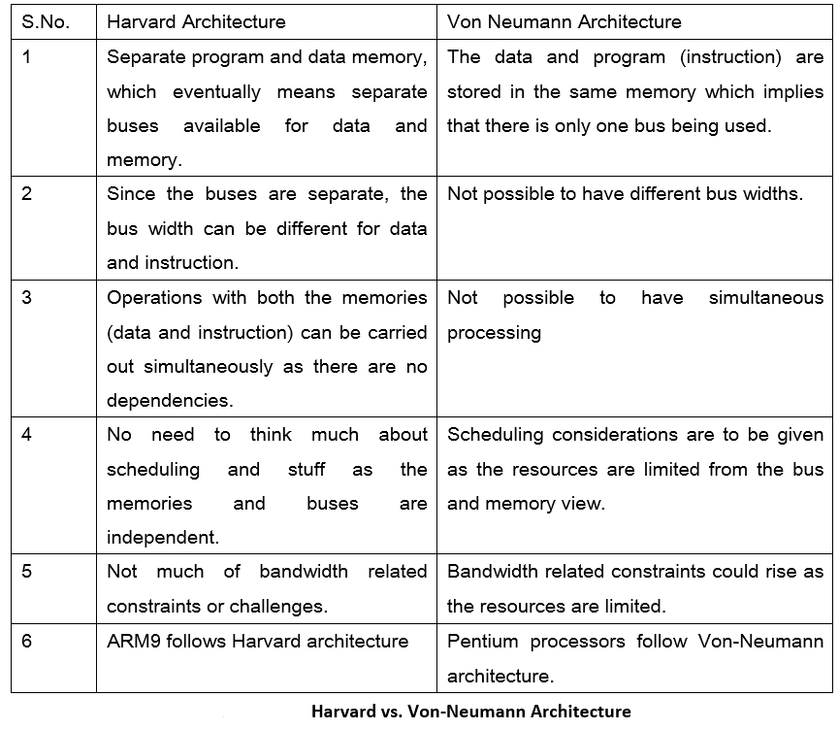
Harvard Architecture – A diagrammatic representation
Von Neumann Architecture – A diagrammatic representation.

Slide 12
Addressing modes

Slide 13
Remember
Addressing mode: The rule for interpreting or modifying the address field of an instruction.
Effective address: The address of operand produced by the application of the rule for interpreting or modifying the address field of the instruction before the operand is actually referenced.

Slide 14
Addressing Modes How do I travel to the destiny?
Common addressing modes are:
Immediate
Direct
Indirect
Register
Register Indirect
Displacement (Indexed)
Stack

Slide 15
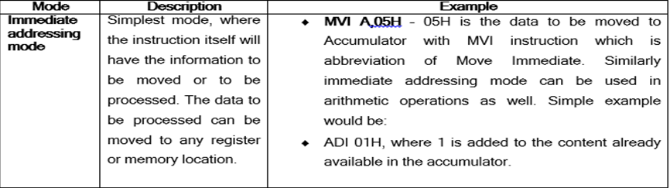
Immediate Addressing
Instruction
OPCODE OPERAND

Slide 16
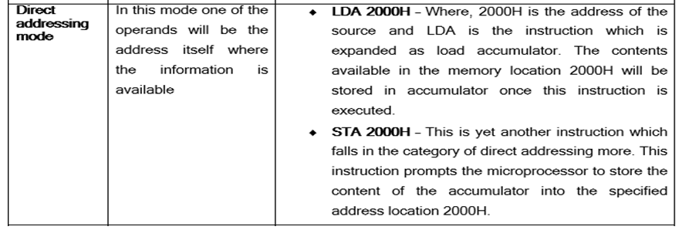
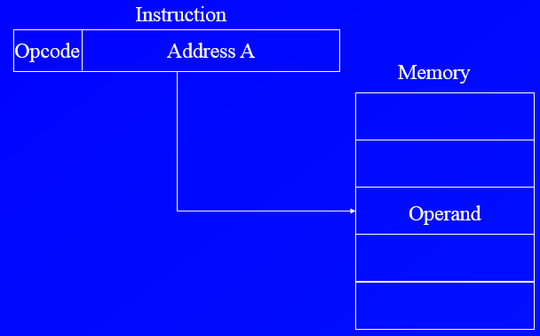
Direct Addressing Mode.

Slide 17
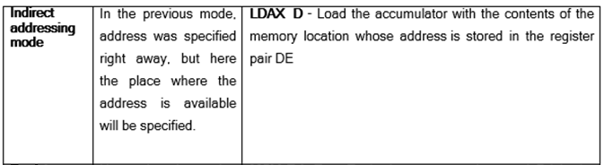
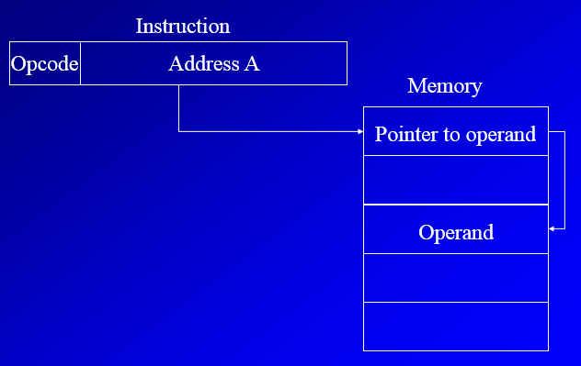
Indirect Addressing mode..

Slide 18
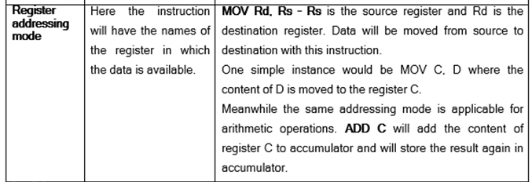
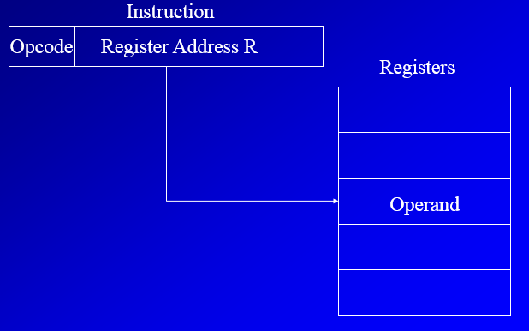
Register Addressing Mode.

Slide 19
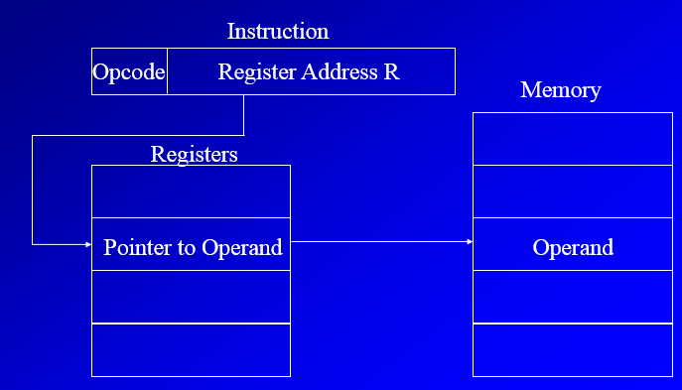
Register Indirect Addressing
EA = (R)
Register indirect addressing is similar to indirect addressing, except that the address field refers to a register instead of a memory location.
Operand is in memory cell pointed to by contents of register R

Slide 20
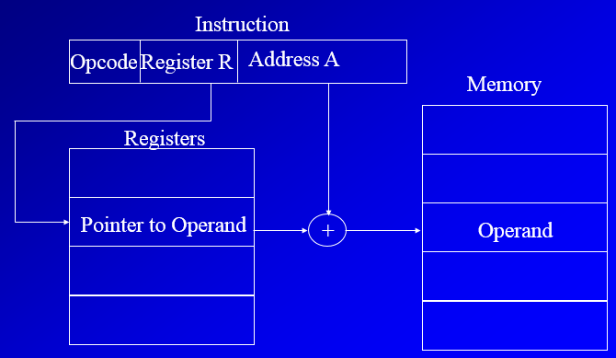
Displacement Addressing (indexed)
EA = A + (R)
Address field hold two values
A = base value
R = register that holds displacement
or vice versa
A very powerful mode of addressing combines the capabilities of direct addressing and register indirect addressing, which is broadly categorized as displacement addressing

Slide 21
Stack addressing mode..
Operand is (implicitly) on top of stack
e.g.
ADD Pop top two items from stack and add

